Slide 1
Capstone Project
EDA
Airbnb Bookings Analysis
Team Members:
Tembhare Kunal
Lakdawala Ali Asgar

Slide 2
CONTENT
Introduction/Background
Data exploration and Preparation
General overview of dataset
Missing value Handling
EDA and Data Visualization
Conclusion

Slide 3
Introduction
Airbnb is an American company which hosts an online marketplace and hospitality service, for people to rent or lease lodging. The company doesn't own any lodging.
Since 2008, guests and hosts have used Airbnb to expand on traveling possibilities and present a more unique, personalized way of experiencing the world.
Airbnb became one of a kind service that is used by the whole world. Data analysts become a crucial factor for the company that provided millions of listings through Airbnb.
These listings generate a lot of data that can be analyzed and used for security, business decisions, understanding of customers’ and providers’ behavior on the platform, implementing innovative additional services, guiding marketing initiatives, and much more.

Slide 4
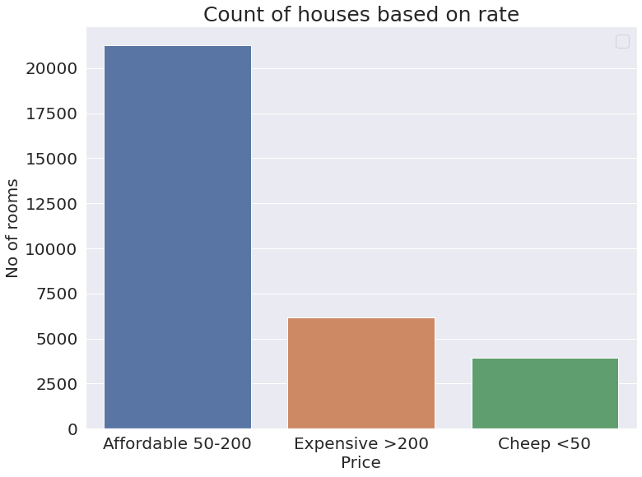
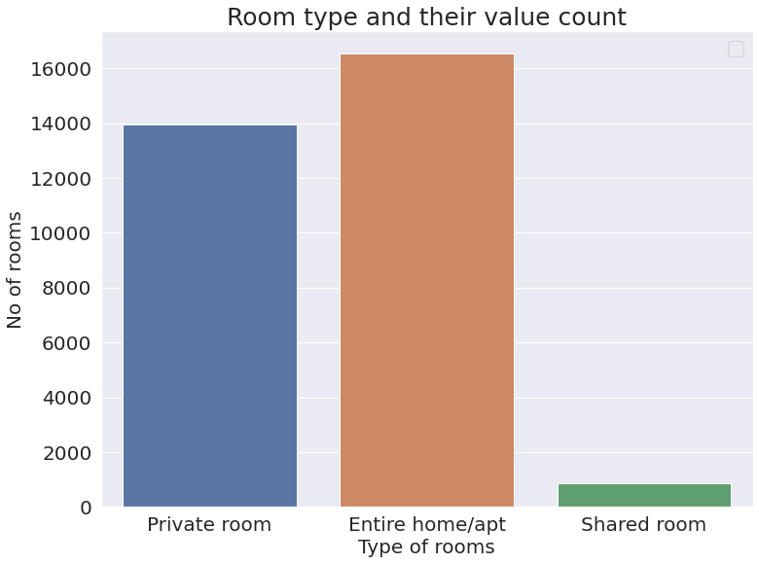
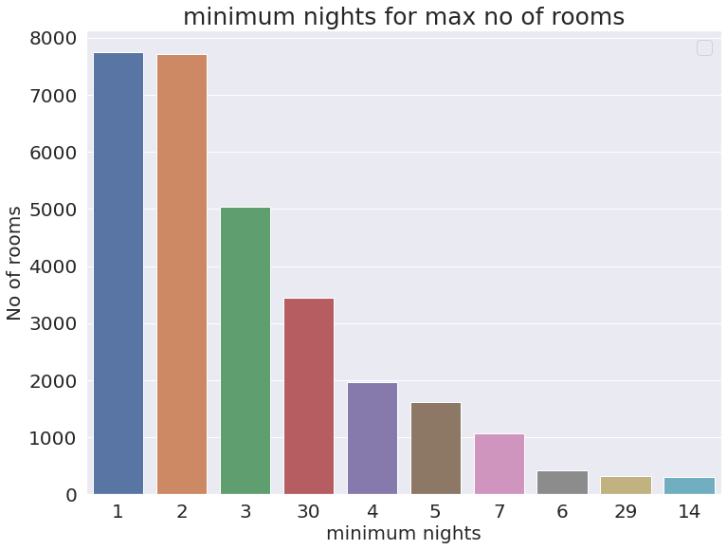
General overview of dataset
name = Description about the listings
host_id = unique id for each listed hosts. (21808 unique host listed their properties )
host_name = Host name for the listings.
neighbourhood_group = Location
neighbourhood = Area
latitude = Latitude coordinates
longitude = Longitude coordinates
room_type = Listing space types
price = Price in dollars
minimum_nights = Minimum nights allowed to stay
number_of_reviews = No. of reviews written against the listing
last_review = Last reviewed date against the listing
reviews_per_month = Total review per month against the listings
calculated_host_listings_count = Total no of listing against the given host id
availability_365 = Availability of the listings throughput the year.

Slide 5
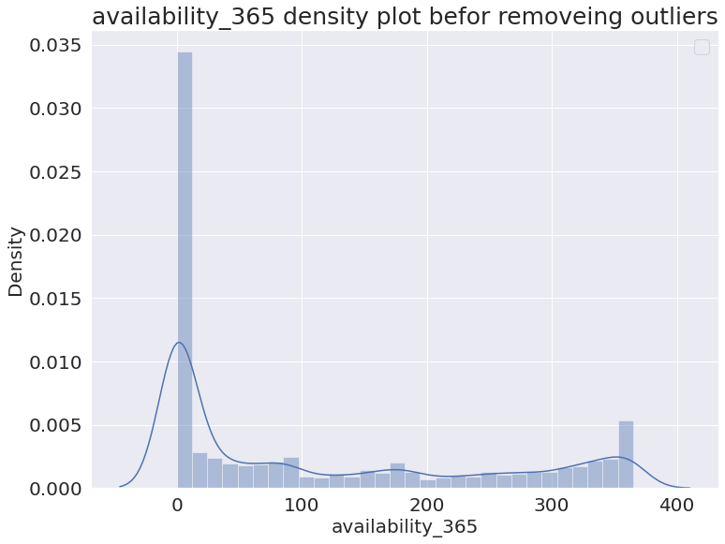
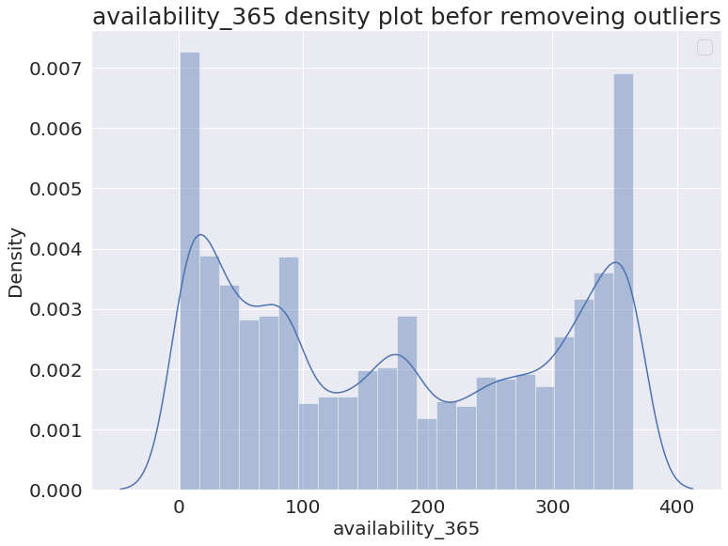
Missing value Handling.
‘reviews_per_month’ - Replaced null values with 0
‘Price’= 0 - Removed 11 values
‘Availability_365’= 0 - Removed 17533 values
‘name’- Replaced null values with neighbourhood + room type
‘host_name’ - Replaced null values with host_id
‘last_review’ - Converted its data type to datetime

Slide 6
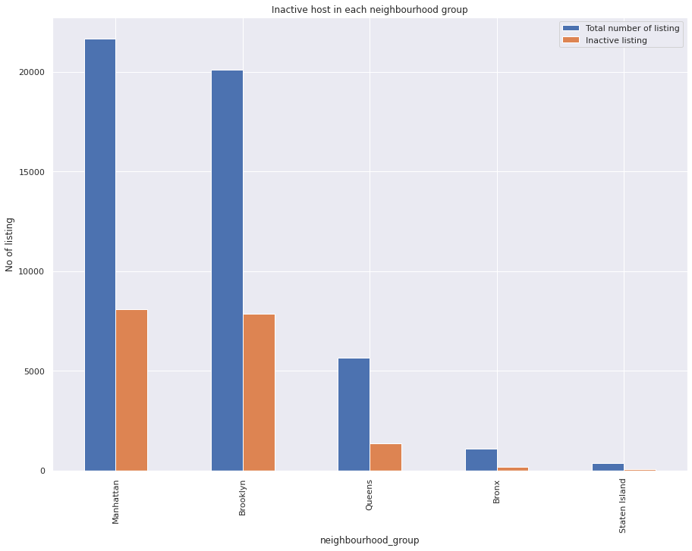
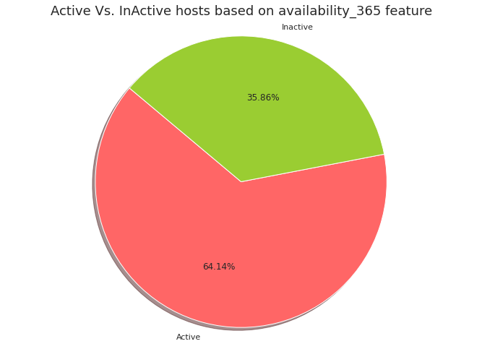
History of Airbnb Listings
cxxxdddddddddddfdfdd
The number of listings that are inactive is directly proportional to the density of listings in the neighbourhood.

Slide 7
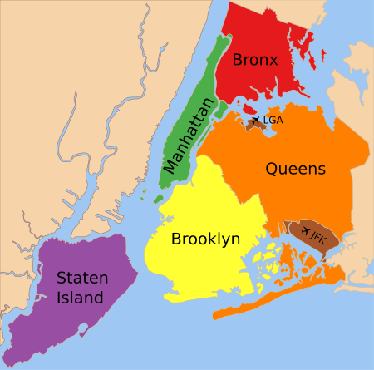
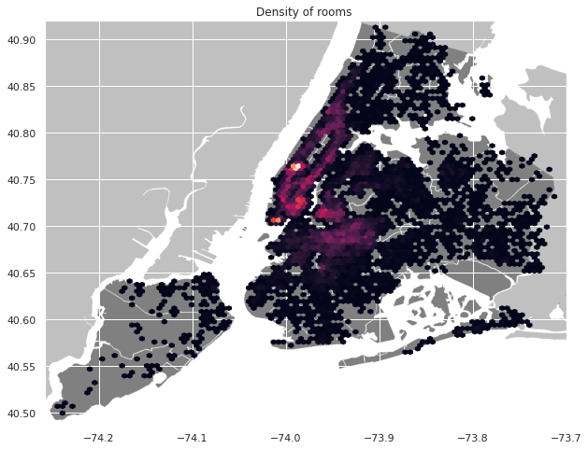
Difference of traffic among different areas
Density of hotels is large in manhattan and places in close contact of manhattan financial district.

Slide 8
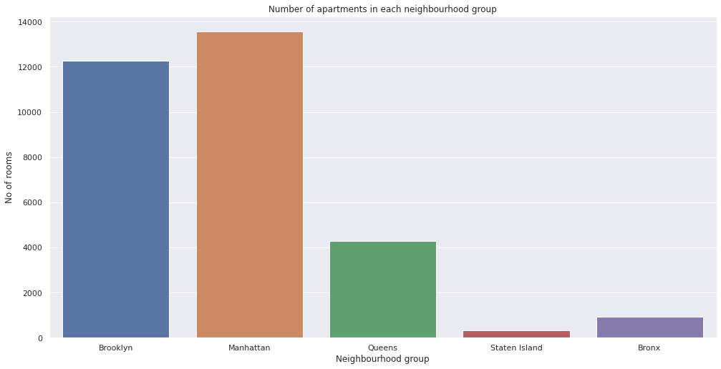
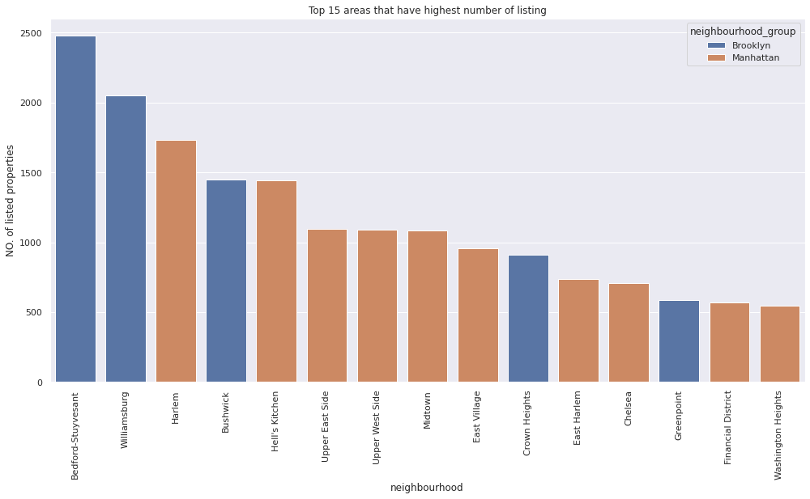
Overall Listings to Identify market
The Manhattan and Brooklyn make up ~82% of all the listings in New york, leaving more opportunity in the remaining neighbourhood group.

Slide 9
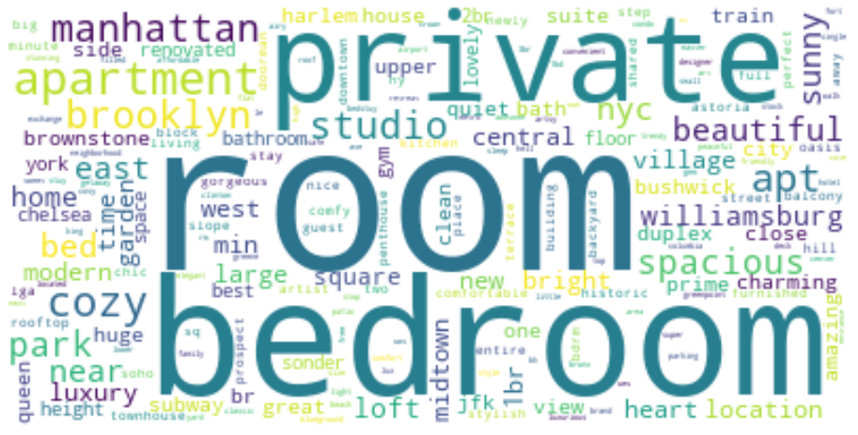
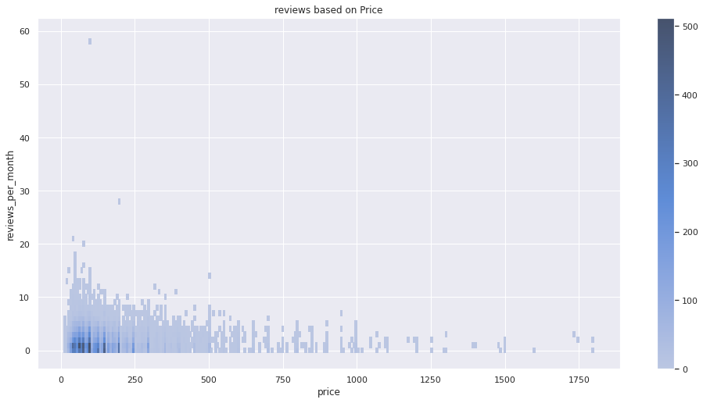
Words used to attract people
Does reviews affect the price
Most of words are the location, view, and type of rooms.

Slide 10
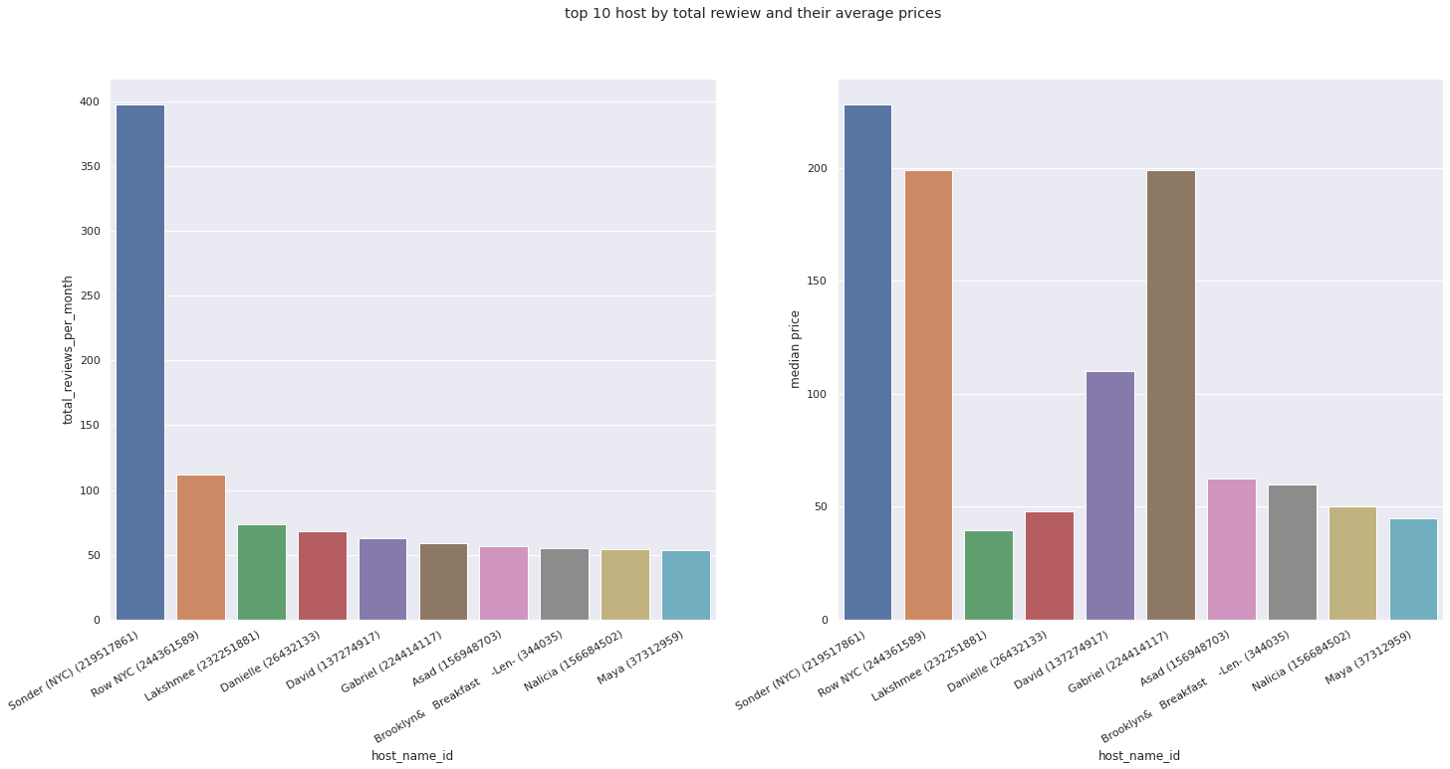
Most busy host’s
Most of the hosts have their price below average(median) i.e 112

Slide 11
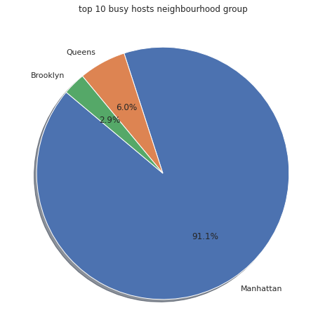
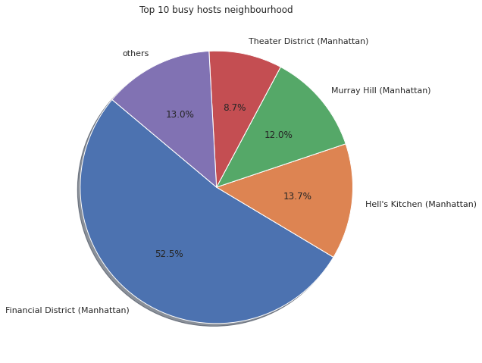
Most of the listing are in financial district of Manhattan

Slide 12
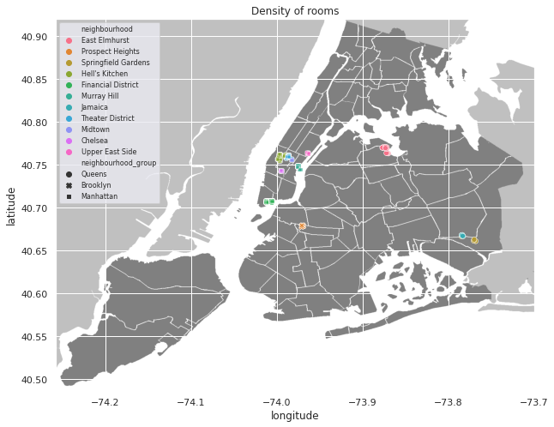
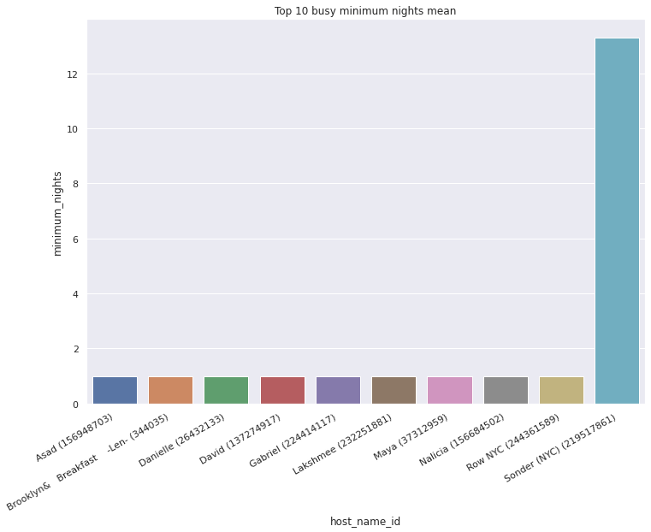
Most of their listing in lower manhattan or are near airport and probably focus on tourist rentals

Slide 13
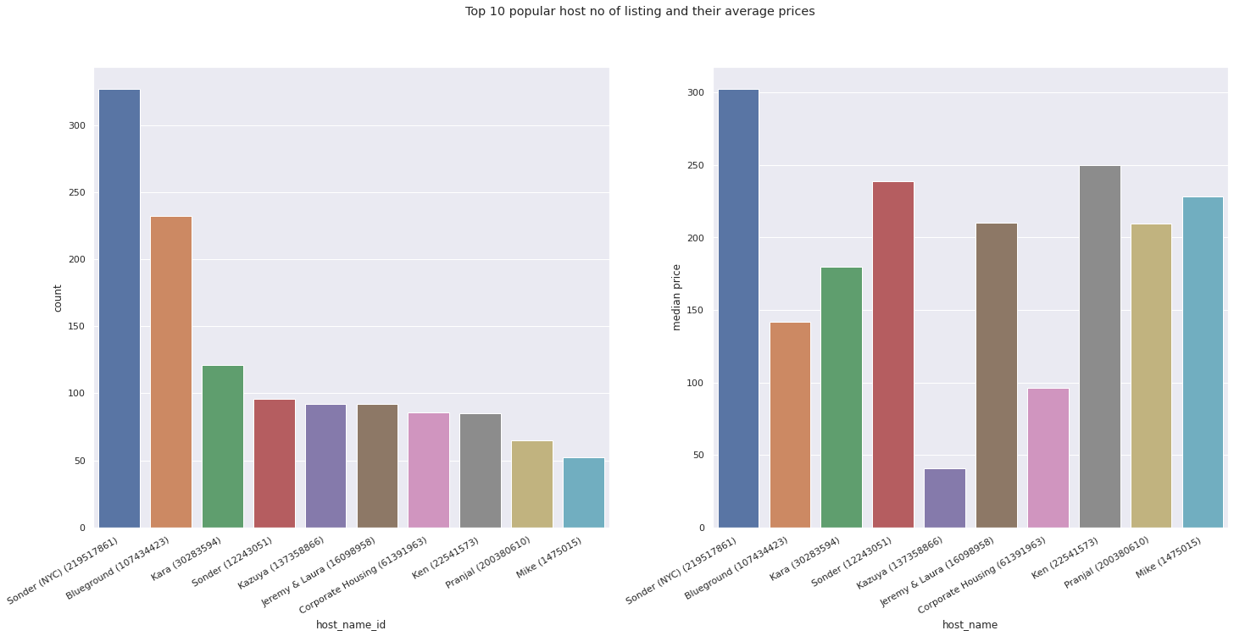
Most popular host’s
Most of the hosts have their price above average(median) i.e 112

Slide 14
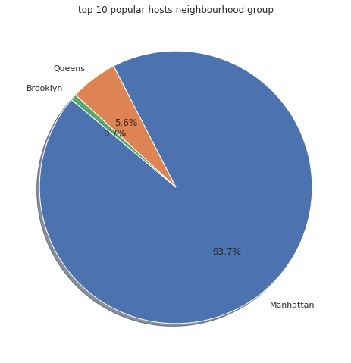
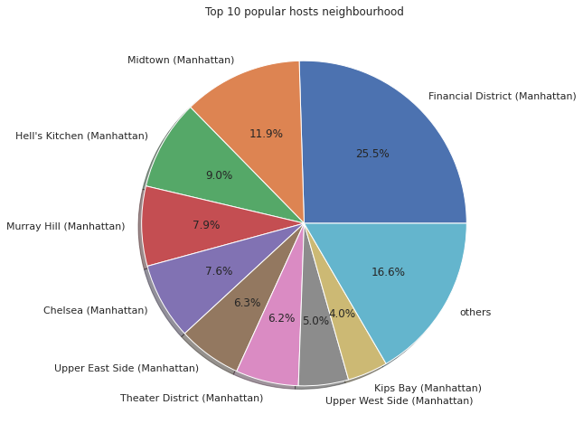
Most of the listing of Manhattan

Slide 15
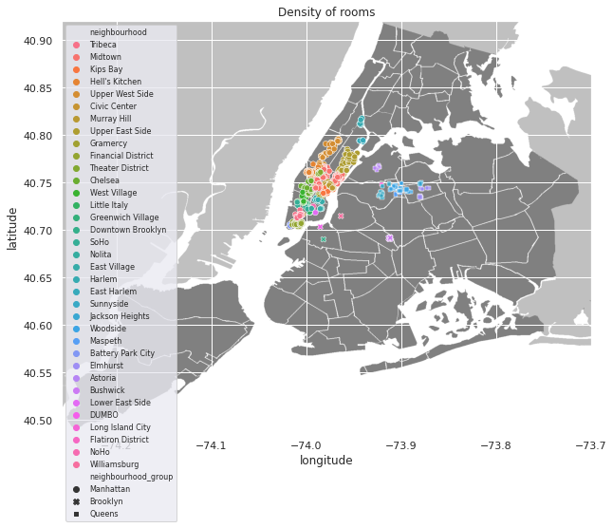
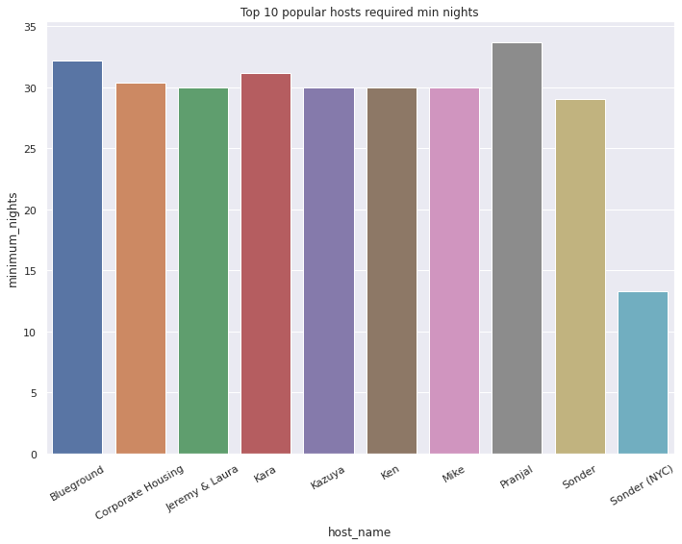
Most of their listing in lower Manhattan or are near Manhattan and probably focus on business rentals

Slide 16
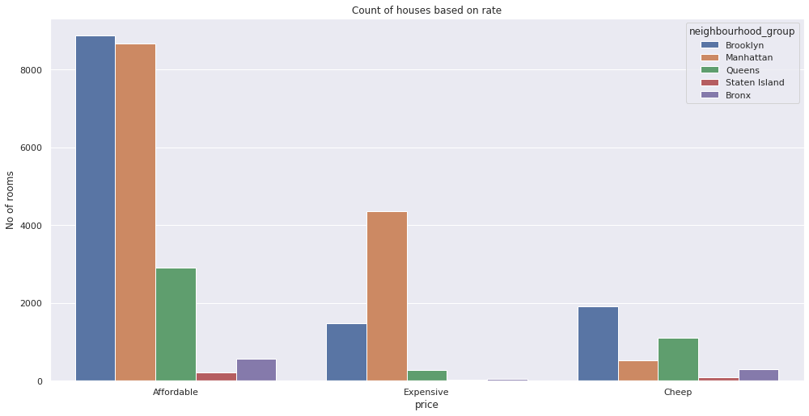
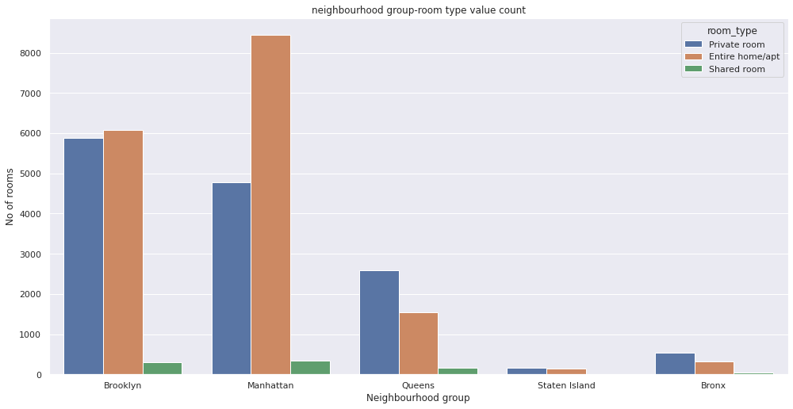
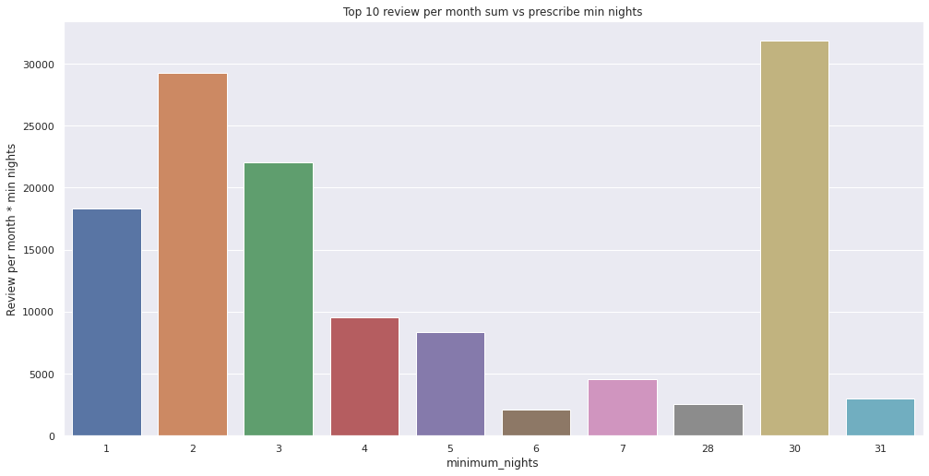
Ideal room conditions to gain max out of it
People prefer rooms in the range of 50-200 in or near manhattan with min nights as (1,2,3 or 30)

Slide 17
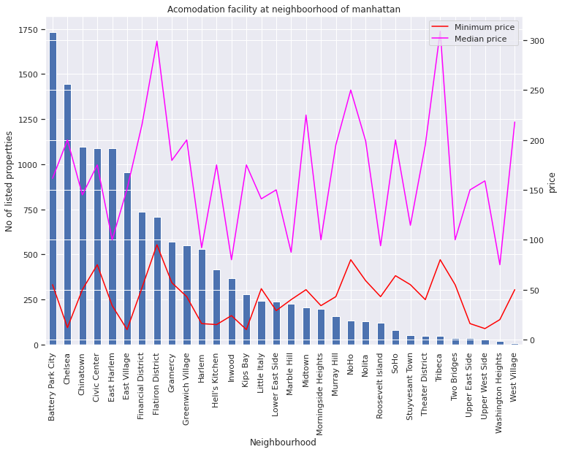
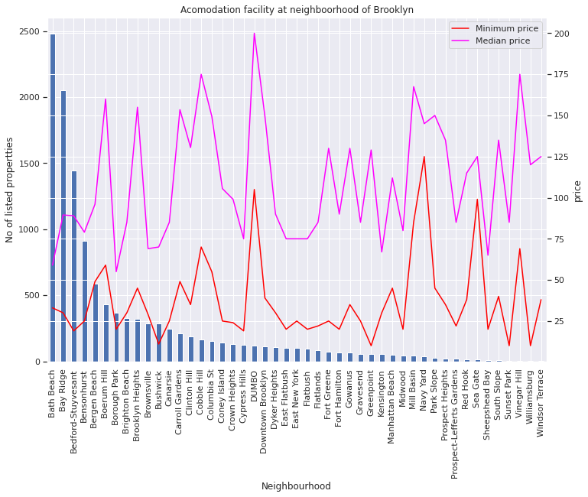
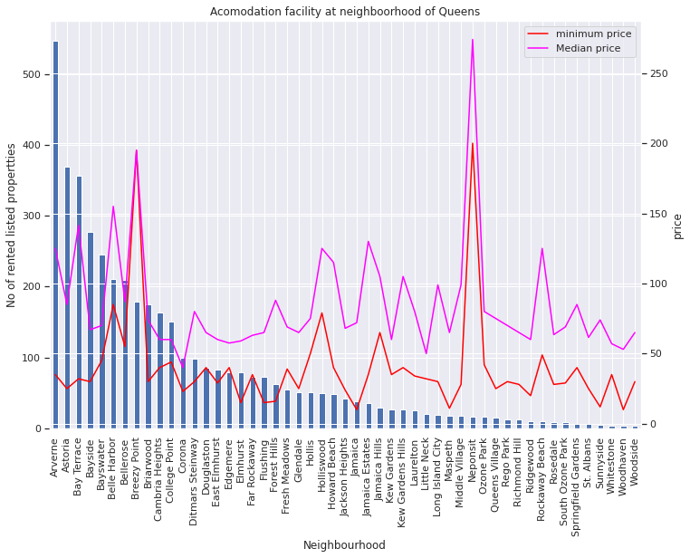
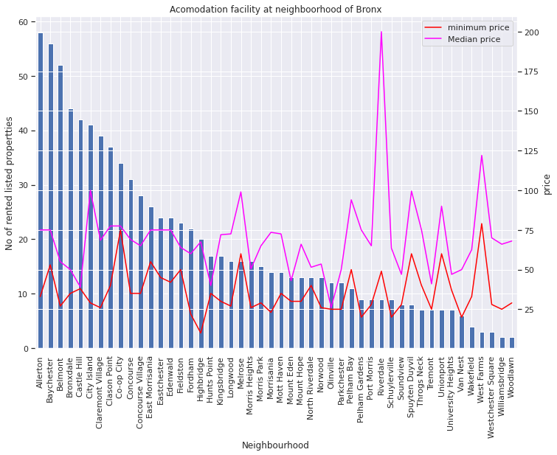
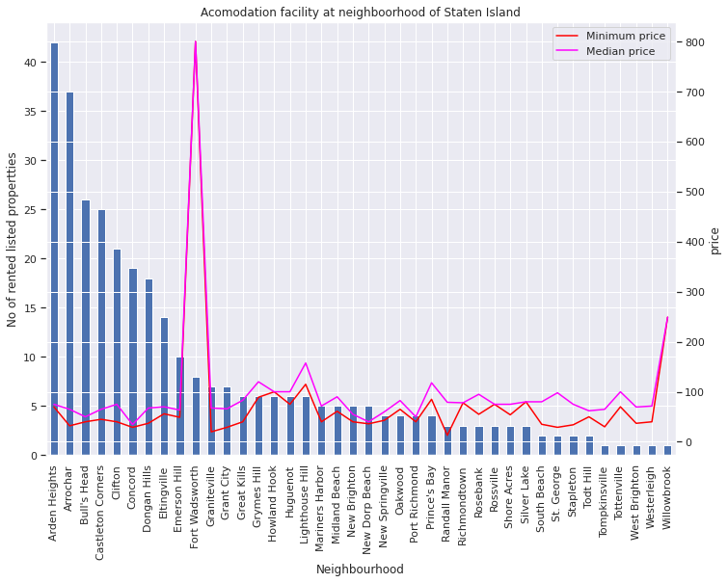
Price distribution neighbourhood wise
Notes:
Flatiron district and tribeca is most expensive neighbourhood in manhattan. (Tribeca is a hip area known for its old industrial buildings. Historic commercial buildings include the red-brick New York Mercantile Exchange edifice. though Washington Market Park and Hudson River Park draw families. ) (A focal point is Madison Square Park, known for its seasonal art installations and the long line at the original Shake Shack.)
Dumbo are most expensive neighbourhood in brooklyn.
Number of neighbourhood where properties are listed in bronx is 48. Riverdale in Bronx is most expensive
Fort wadsworth is most expensive neighbourhood in staten island.

Slide 18
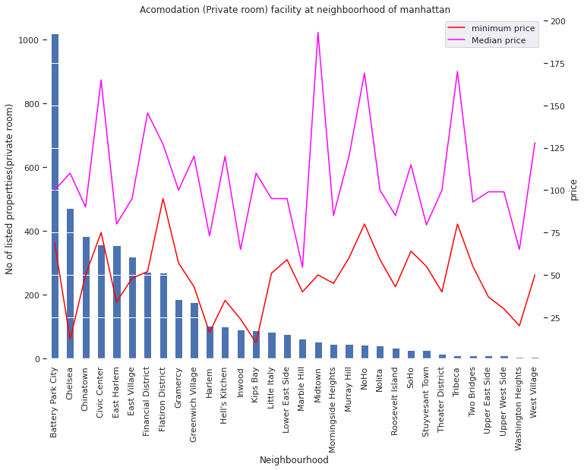
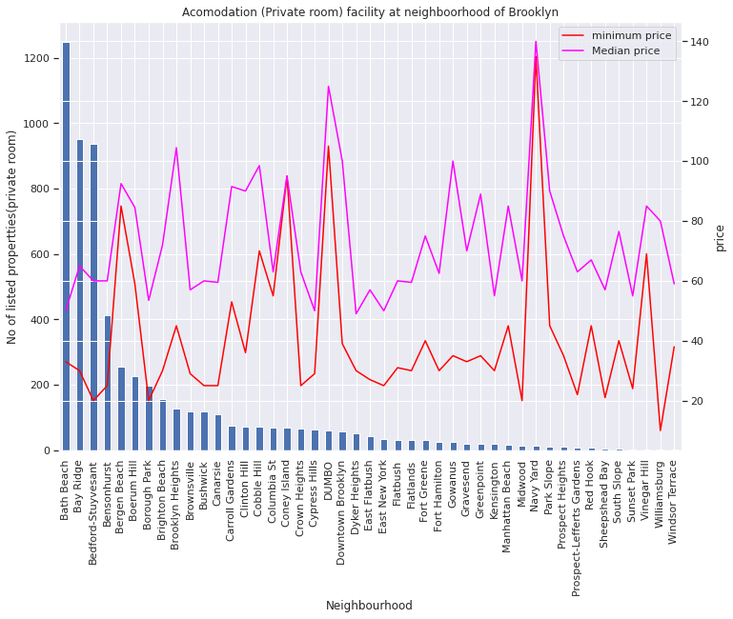
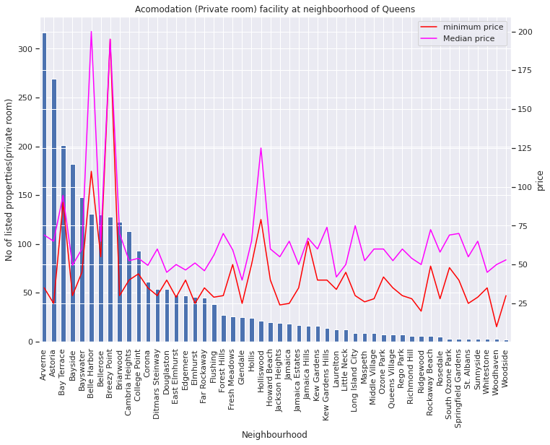
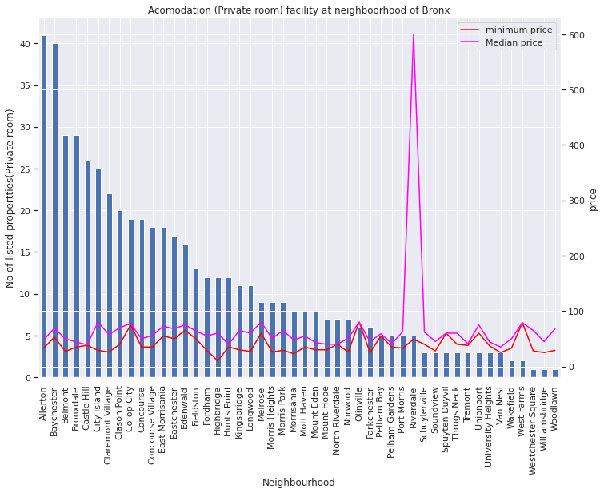
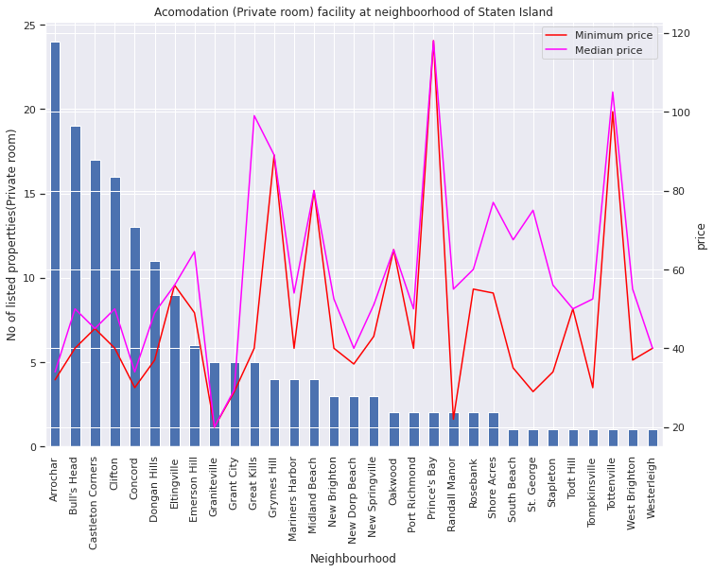
Price distribution for Private room
Notes:
Number of neighborhoods in Manhattan where rental private room is listed: 32
Brooklyn = 45, Queens= 50, Bronx= 48, Staten Island=31
Median -minimum range =
Manhattan = $20-$170, mid-Town most expensive $200
Brooklyn=$20-$100, Navy yard most expensive $140
Queens=$20-$80, Bayswater and Breezy point most expensive
bronx= $20-80, riverdale most expensive median price= 600
Staten Island = $20 - $120, Prince’s bay most expensive.

Slide 19
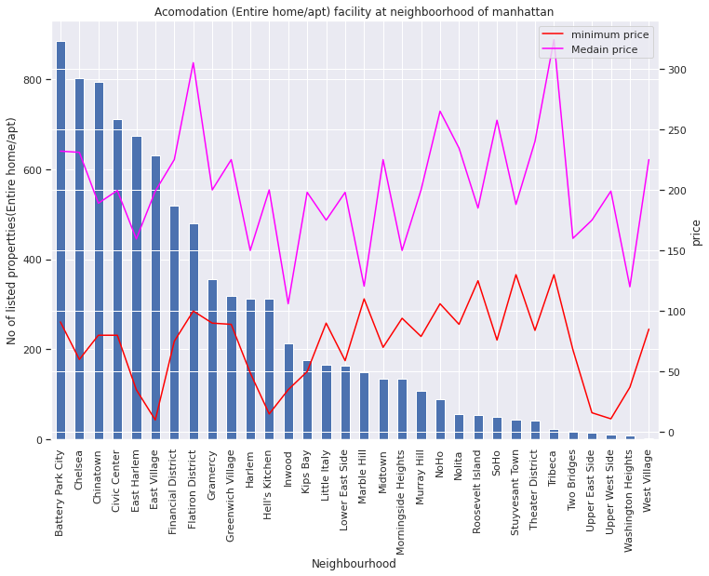
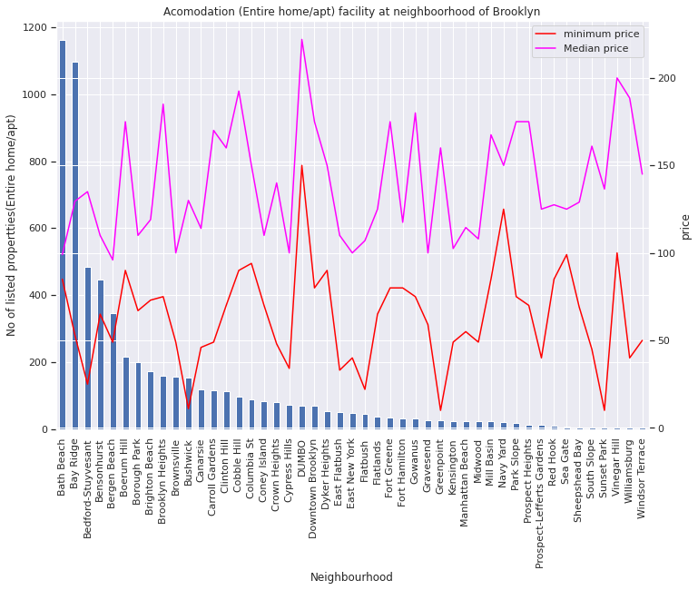
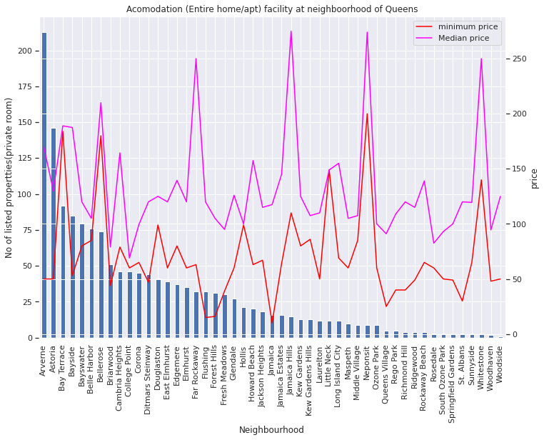
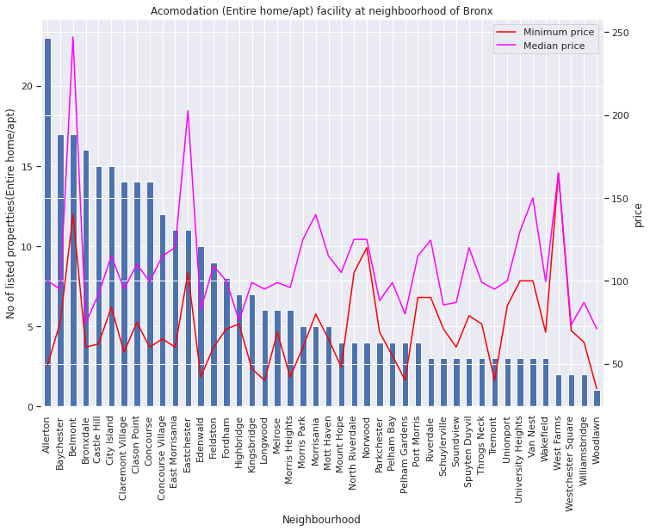
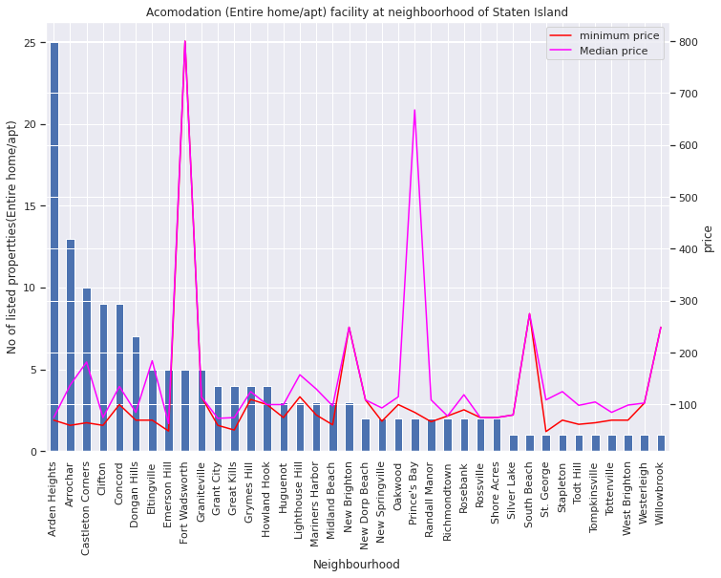
Price distribution for Entire Apt/home
Notes:
Number of neighborhoods in Manhattan where rental entire apt is listed: 32
Brooklyn = 47, Queens= 49, Bronx= 44, Staten Island=38
Median -minimum range =
Manhattan = $50-$270, flatiron District and Tribeca most expensive around $310
Brooklyn=$50-$200, Dumbo most expensive $250
Queens=$50-$250, Jamaica Hills and Neponsit most expensive
bronx= $50-130, Belmont most expensive median price= 250
Staten Island = $20 - $120, Prince’s bay and Fort Wadsworth most expensive.

Slide 20
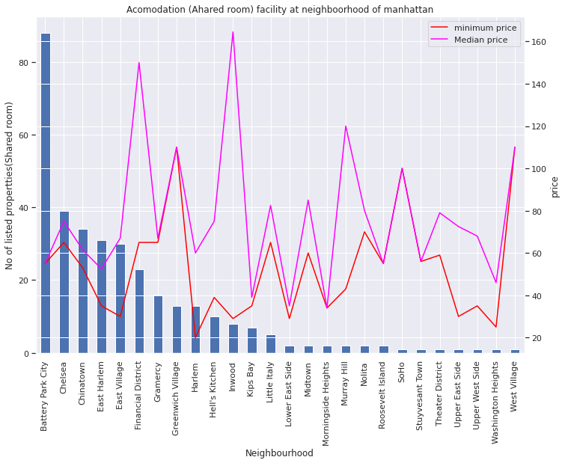
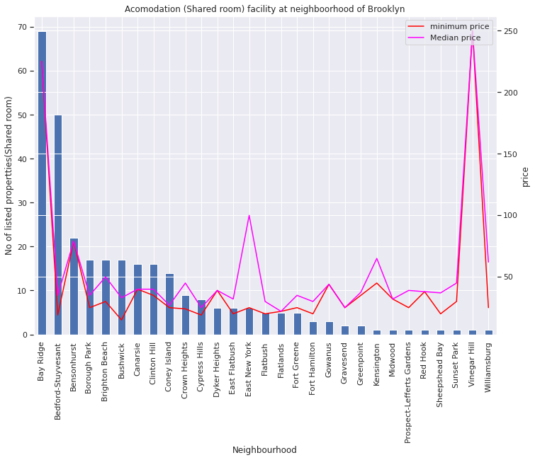
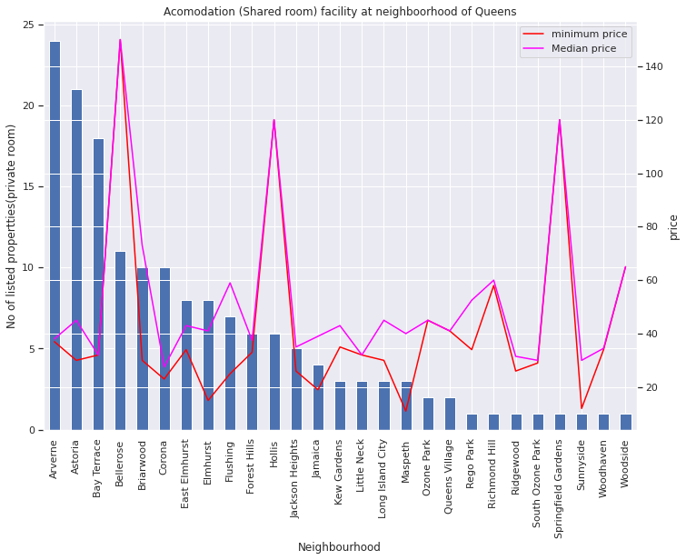
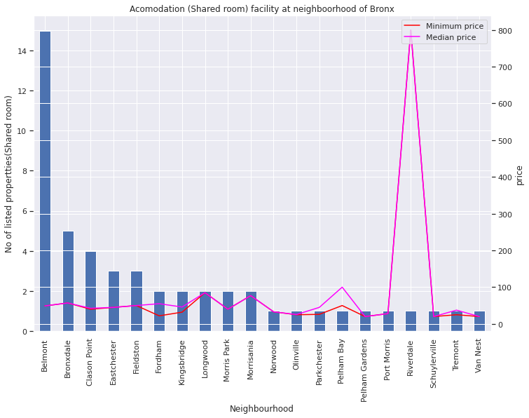
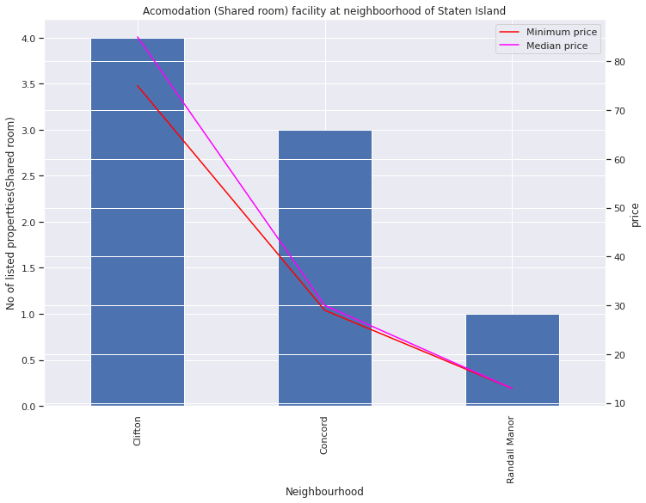
Price distribution for Shared room
Notes:
Number of neighborhoods in Manhattan where rental private room is listed: 26
Brooklyn = 29, Queens= 27, Bronx= 20, Staten Island=03
Median -minimum range =
Manhattan = $20-$100, Financial District most expensive $140
Brooklyn=$20-$50, Bay Ridge and Vinegar Hill most expensive around $ 200
Queens=$20-$60, Bellerose and Springfield Gardens are most expensive
bronx= $20-50, riverdale most expensive median price= 800

Slide 21
Conclusion
There are 36 percent of inactive hosts. Which are directly proportional to the density of listings in the neighbourhood.
Typical words that are used by the host to make their listing easily searchable are based on the location, view, and type of rooms.
People prefer higher rated accommodation which costs less than the average price.
Most of the busy hosts have their price below average(median), Most of the listing are in financial district of Manhattan or are near airport and probably focus on tourist rentals.
Most of the popular hosts have their price above average(median), Most of their listing are in lower Manhattan or are near Manhattan and probably focus on business rentals.
People prefer entire or private rooms in manhattan or Brooklyn with a price range 50-200
We can state that Manhattan has the highest range price for the listings, followed by Brooklyn with $100 per night.
Queens and Bronx seem to have a very similar price distribution and Staten Island is the cheapest among all.

